Slide 1
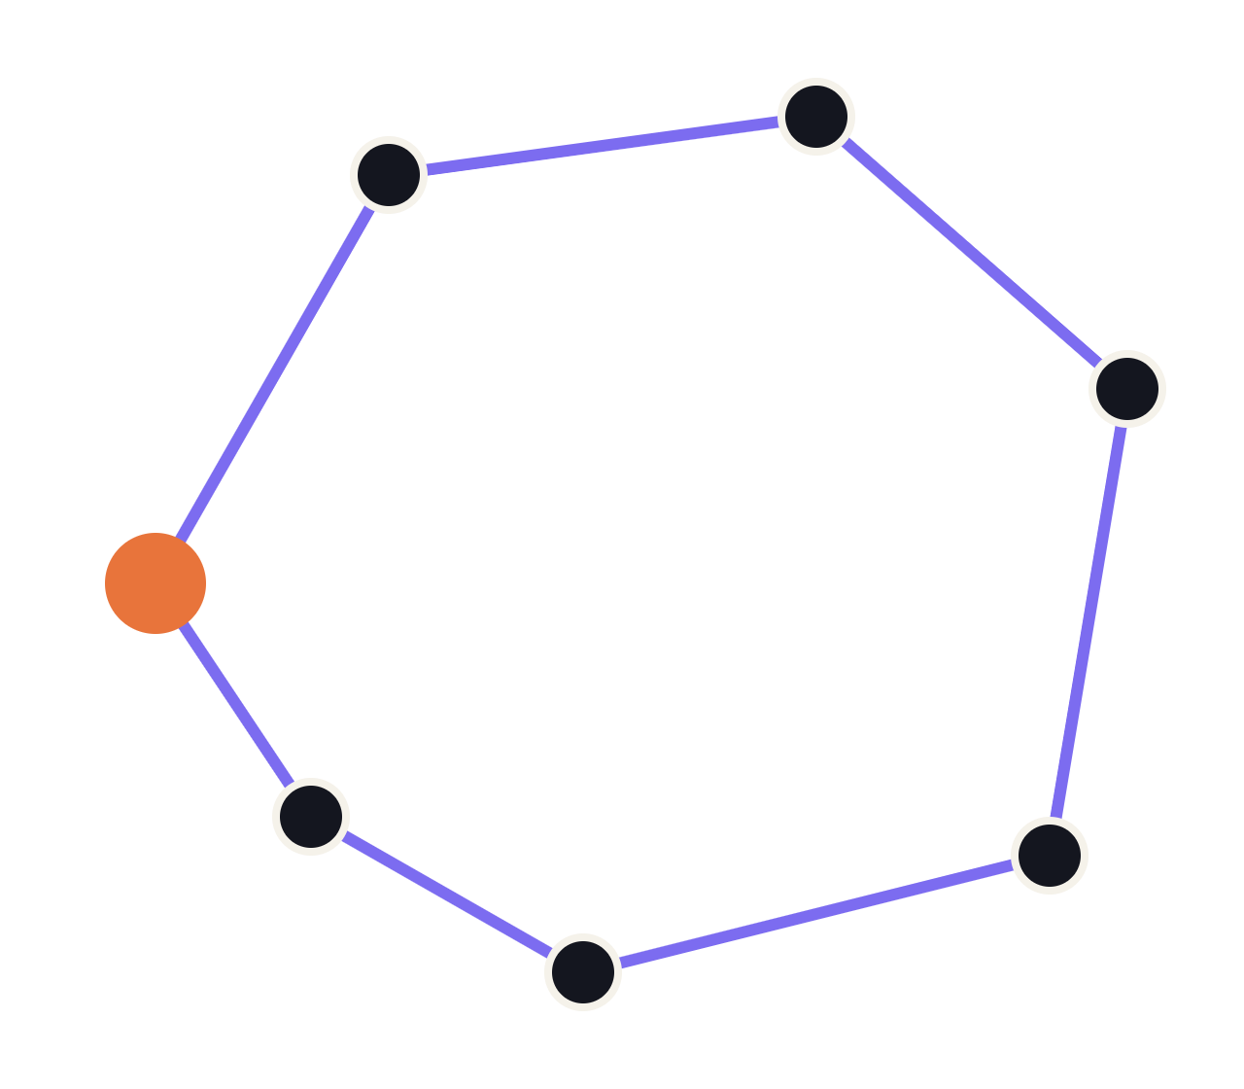
The Travelling Salesman Problem
COMBINATORIAL OPTIMIZATION
Finding the shortest round trip through every city, and why it is so hard
Notes:
Welcome. The travelling salesman problem, or TSP, is one of the most studied problems in computer science. It's easy to state, very hard to solve exactly, and a great showcase for both exact algorithms and heuristics.

Slide 2
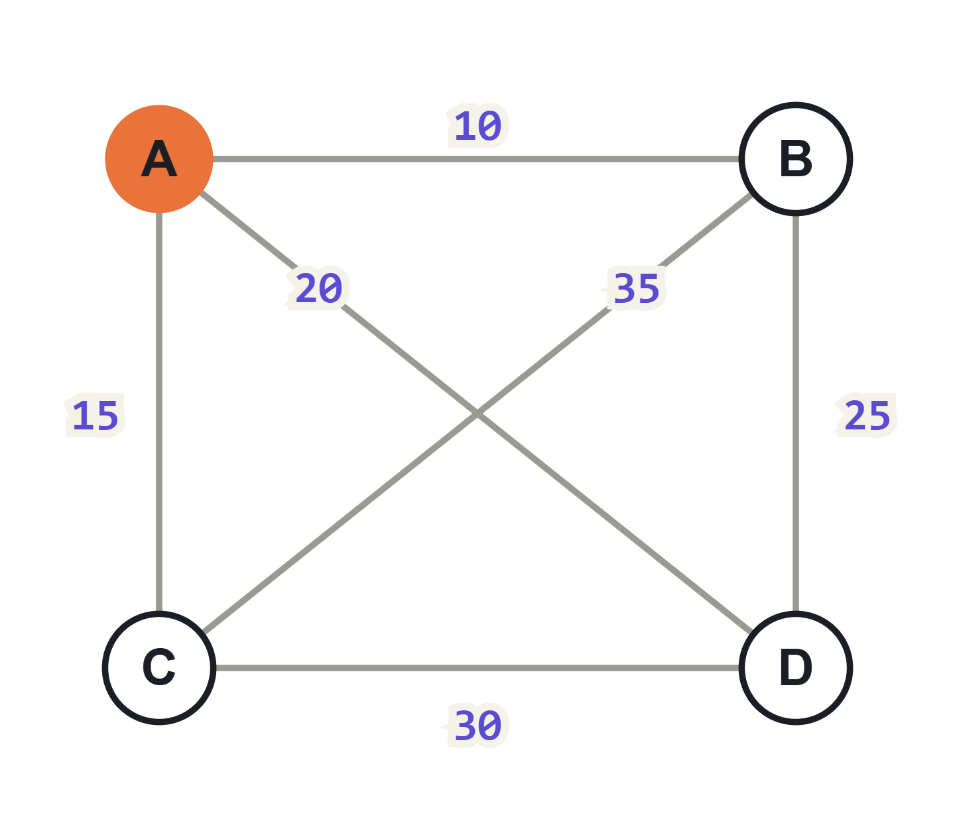
The problem
A salesman must visit every city exactly once and return home. Which order gives the shortest total distance?
01
Input: cities and the distance between each pair
02
Output: a closed tour through all of them
03
Goal: minimize the tour's total length
02
Notes:
Our running example: four cities, starting at A (orange). Distances are symmetric, so A to B equals B to A. Ask the audience to guess the best tour before the reveal.

Slide 3
Why it is hard
4 cities
3 tours
(n−1)!/2
10 cities
181,440
distinct round trips for n cities: fix the start, order the rest, and each tour counts twice (once per direction).
15 cities
~4.4 × 10¹⁰
20 cities
~6.1 × 10¹⁶
NP-hard
No known algorithm solves every instance in polynomial time, and finding one would settle P vs NP.
03
Notes:
Factorial growth outpaces exponential growth. Even at a billion tours per second, 20 cities would take around two years by brute force. That's why practical TSP work relies on clever exact methods and on heuristics.

Slide 4
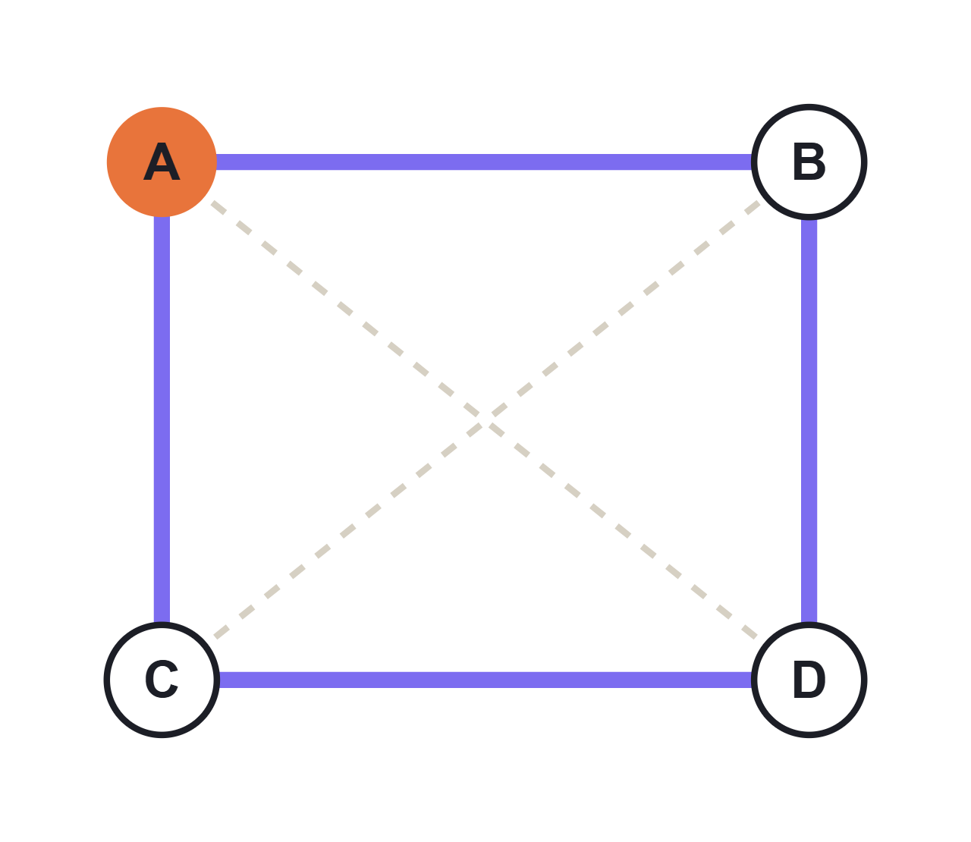
Brute force on our example
A → B → C → D → A
95
10 + 35 + 30 + 20
A → B → D → C → A
80
10 + 25 + 30 + 15 · shortest
A → C → B → D → A
95
15 + 35 + 25 + 20
04
Notes:
With 4 cities there are only 3 distinct tours, so we can check them all. The winner, 80, goes around the outside and skips both long diagonals. This approach is correct but O(n!), so it stops being usable past roughly a dozen cities.

Slide 5
Exact methods: always optimal
Brute force
Held–Karp
Branch and cut
O(n!)
O(n²·2ⁿ)
varies
Linear programming plus pruning. Behind solvers like Concorde that crack very large instances.
Try every ordering. Simple, but only practical for about a dozen cities.
Dynamic programming over subsets of cities (1962). Still exponential, but far less than n!.
At 20 cities
Held–Karp needs about 4 × 10⁸ steps; brute force faces about 6 × 10¹⁶ tours.
05
Notes:
Held–Karp was published independently by Bellman and by Held and Karp in 1962. Branch and cut doesn't have a clean worst-case bound but is what serious exact solvers use in practice.

Slide 6
THE HELD–KARP RECURRENCE
C(S, j) = length of the shortest path that starts at city 1, visits every city in set S once, and ends at j.
C(S, j) = min over i in S − {j} of
C(S − {j}, i) + d(i, j)
best way to cover the rest, ending at i
plus the last hop from i to j
Answer: min over j of C(all, j) + d(j, 1)
06
Notes:
The key insight: once you know which cities you've visited and where you are now, the order you visited them in no longer matters. That collapses n! orderings into 2^n subsets times n end cities.

Slide 7




Heuristics: good tours, fast
Nearest neighbour
2-opt improvement
Always go to the closest unvisited city. O(n²), no quality guarantee.
Repeatedly swap two edges when it shortens the tour.
Christofides
Metaheuristics
Guaranteed within 1.5× optimal when distances obey the triangle inequality.
Simulated annealing, genetic algorithms, ant colony optimization.
07
Notes:
Heuristics trade the optimality guarantee for speed. In practice a constructive heuristic like nearest neighbour builds a tour, then a local search like 2-opt polishes it.

Slide 8
Nearest neighbour, step by step
A → B
Closest of B 10, C 15, D 20
+10
TOUR LENGTH
B → D
Closest of C 35, D 25
+25
80
Optimal here, by luck. On larger maps, early greedy choices can force long jumps at the end.
D → C
Only C is left
+30
C → A
Return home
+15
08
Notes:
Nearest neighbour is the most intuitive heuristic. On this small example it happens to find the optimum, 80. In general there is no constant-factor guarantee: the final steps often have to backtrack across the map.

Slide 9
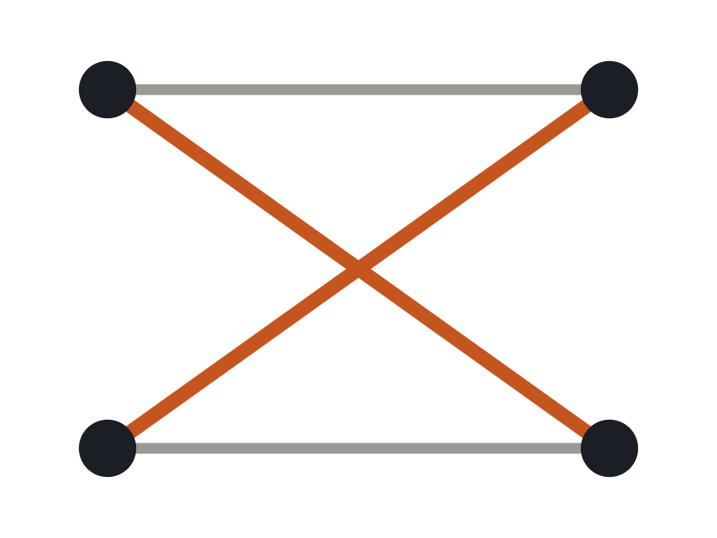
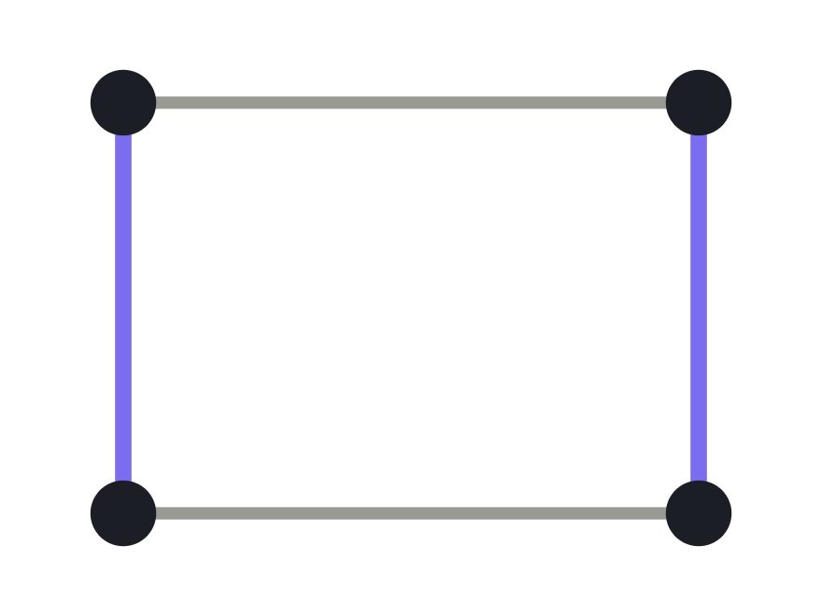

2-opt: remove the crossings
BEFORE: EDGES CROSS
AFTER: SHORTER
The move
Delete two edges, reconnect the ends the other way (reversing the segment between them), keep it if shorter. Repeat until no swap helps.
09
Notes:
In the plane, a tour with crossing edges can always be shortened by uncrossing them, which 2-opt does. The result is a local optimum: no single 2-edge swap improves it, though it may not be globally best.

Slide 10
Choosing an approach
Method | Tour quality | Time
Brute force | Optimal | O(n!)
Held–Karp | Optimal | O(n²·2ⁿ)
Christofides | At most 1.5× optimal (metric) | O(n³)
2-opt (one pass) | Local optimum | O(n²)
Nearest neighbour | No guarantee | O(n²)
Small n and you need the best? Go exact. Thousands of cities? Build with a heuristic, then improve with 2-opt.
10
Notes:
"Metric" means distances obey the triangle inequality: going direct is never longer than going via a third city. Road distances and straight-line distances both qualify.

Slide 11
In code: brute force in Python
How it works
Fix city 0 as the start, try every order of the others, keep the cheapest.
from itertools import permutations
def tsp_brute_force(d):
n = len(d)
best_cost, best_tour = float('inf'), None
for perm in permutations(range(1, n)):
tour = (0,) + perm + (0,)
cost = sum(d[a][b] for a, b in zip(tour, tour[1:]))
if cost < best_cost:
best_cost, best_tour = cost, tour
return best_cost, best_tour
Our example
A, B, C, D = 0, 1, 2, 3
→ (80, (0, 1, 3, 2, 0))
11
Notes:
d is a distance matrix: d[i][j] is the distance from city i to city j. Fixing city 0 removes rotations of the same tour. Swap the loop for a dictionary over (visited set, last city) and you get Held–Karp.

Slide 12



Where it shows up
Delivery and logistics
Manufacturing
Planning routes for couriers, service vans and school buses.
Ordering the holes a machine drills in a circuit board to cut travel time.
Genome mapping
Scheduling
Ordering DNA markers so neighbouring ones are most alike.
Sequencing jobs where switching cost depends on what ran before.
12
Notes:
Real routing problems add constraints like time windows and vehicle capacity, giving vehicle routing problems, but TSP is the core underneath.

Slide 13
Key takeaways
01
Shortest round trip through every city: easy to state, NP-hard.
02
Tours grow as (n−1)!/2, so brute force fails fast.
03
Held–Karp DP is exact in O(n²·2ⁿ).
04
At scale: build with a heuristic, polish with 2-opt.
Notes:
Recap the four points, then take questions.

